Slide 1
Machine Learning in Data Analytics
A workshop within the Data-Centric Engineering scheme

Slide 2
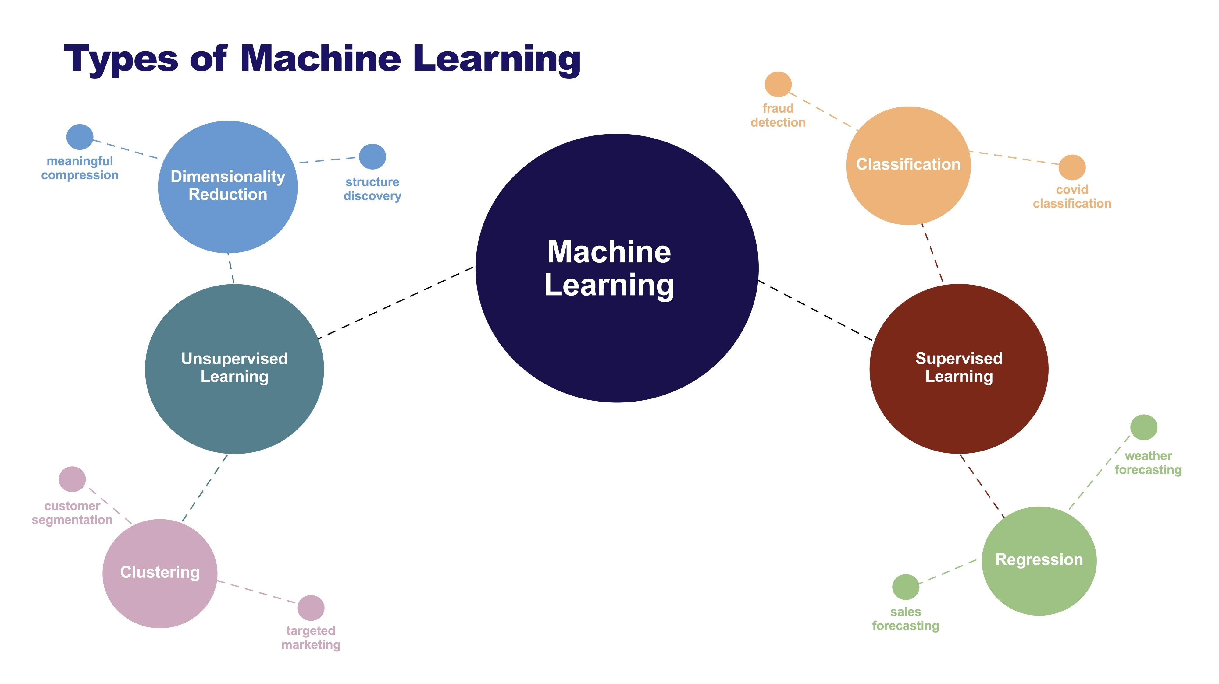
Machine Learning
You create a model not an equation
The model figures out the rules itself
It’s all about pattern
recognition
Data collection →
Feature selection →
Training →
Evaluation

Slide 3

Training a Toddler
We teach by showing examples
Input images of animals
Correct mistakes
The toddler may be able to even identify new breeds
But what do they actually see?

Slide 4
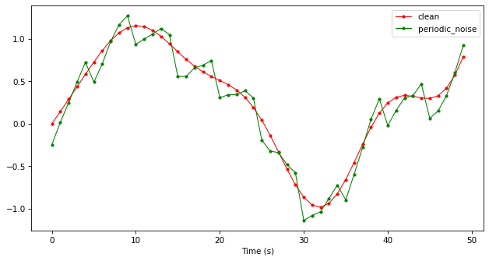
Noise, Drift and Anomalies
Noise can come from EMF, environmental factors and sensor error
Drift can come from sensors, slow mechanical changes
Anomalies can arise in any system
Notes:
Explain why these affect ML and AI

Slide 5
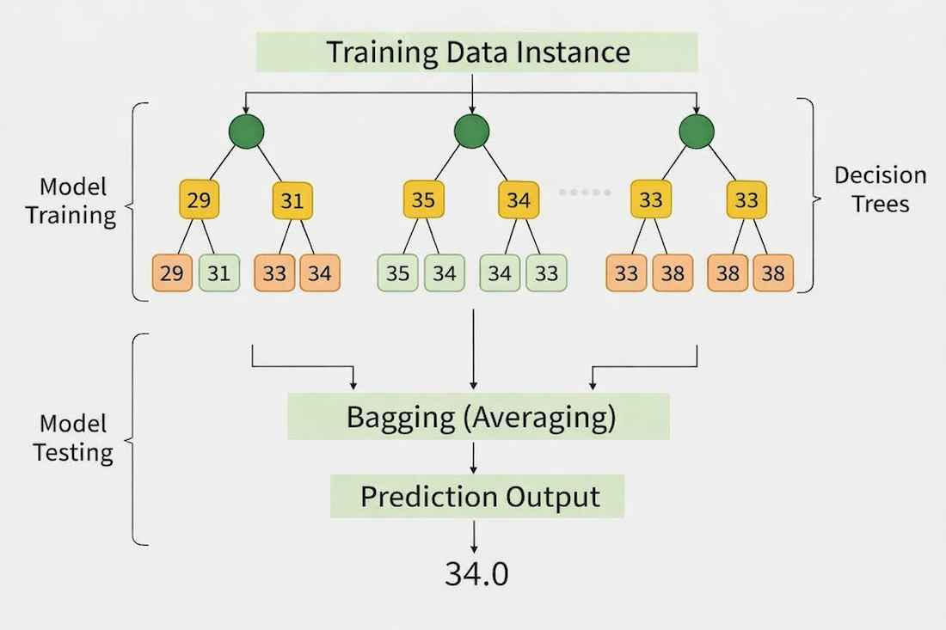
Machine Learning Algorithms
Decision trees
Random forest models →
Linear / logistic regression
K clustering
Convolutional neural networks

Slide 6
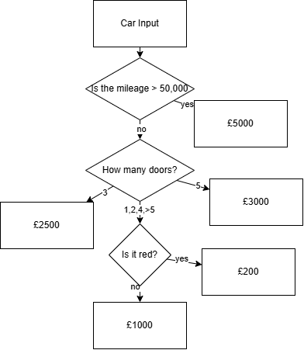
How tree models work
We start off with a decision tree
We send every car on the lot through the tree and then end up at “leaves”.
We use known data and average the results at the leaves.
Very sensitive, brittle and prone to over fitting
A random forest gets the opinions of the whole dealership

Slide 7
Random Forest Regressors
A tree is a decision tree (flow chart)
Trees are at risk of overfitting but using a random forest combines and lets them vote
Random Forests use an ensemble of independent decision trees to reduce prediction variance and prevent overfitting.
Naive models trained on uncleaned time-series typically yield low performance.
Training the exact same algorithm on cleaned, physics-derived engineering features causes accuracy to typically surge without changing model hyperparameters.
Notes:
Talk about the basics of a random forest – what they do and why they benefit so much from feature engineering
MENTION training data etc

Slide 8
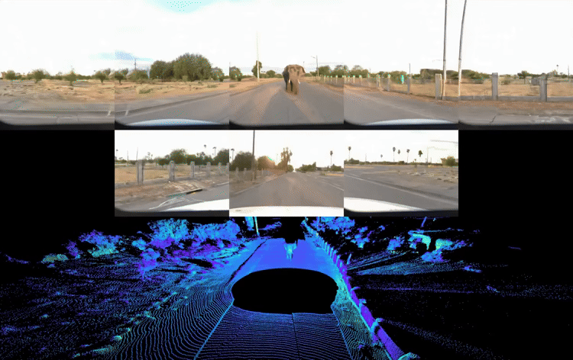
The Limits of Trees
Decision trees predict by averaging training data inside bounding boxes. If the pump operates at an unprecedented high temperature (Out-of-Distribution / OOD), a Random Forest will confidently predict a normal efficiency based on the closest box it knows. It cannot say, "I don't know."
Notes:
Explain OOD and why this is dangerous

Slide 9



Feature Engineering
Dirty carrots → Mise en place → Julienne carrots
Raw Features → Feature extraction → Engineered Features

Slide 10
Feature Engineering
Domain | Raw Data | FE signal
Biomedical | ECG sensor stream | Heart rate Variability
Computer Vision | A full pixel matrix | A histogram of oriented gradients
E-commerce | A full Timestamped log | Average session duration and purchase velocity
Natural Language Processing | Raw text string | TF-IDF vectors and word embedding
Geospatial | GPS coords. | Haversine distance between 2 pings
Raw time-series signals are highly inefficient inputs for shallow ML models.
Root Mean Square (RMS) maps directly to continuous kinetic energy dispersion within structural bearing housings.
Fast Fourier Transforms (FFT) can convert time-domain variables into frequency spectra.
Notes:
Note on Frequency Domain: The curriculum highlights Fast Fourier Transforms (FFT) as the standard for capturing specific bearing fault signatures. For this introductory workshop, we use Vibration RMS as a proxy because it captures the total continuous kinetic energy dispersion in the bearing housings, which shallow tree models can process immediately without a full spectral decomposition

Slide 11
Risk & Uncertainty via Gaussian Processes
Most models are overconfident and will stay like this even out of their bounds.
Tree ensembles and traditional neural networks cannot quantify their own ignorance when extrapolating.
Gaussian Process Regression (GPR) provides non-parametric modelling that outputs explicit uncertainty vectors alongside predictions by running a bunch of mathematically possible outcomes
Notes:
Pragmatic Approximation: True Gaussian Processes provide explicit uncertainty vectors ($\pm2\sigma$) but are highly computationally expensive. In our workshop code, we use tree ensemble spread (the variance across independent decision trees) as a faster, highly visual proxy for model uncertainty when moving into out-of-distribution failure regions.

Slide 12

Driving down a foggy road
There is always a risk of loose gravel or a stray nail (aleatoric risk)
The fog restricts your view (epistemic uncertainty)
A wise model will visualise all the possible paths and slow down because its uncertainty envelope has grown.
A standard ML model will stick as 60mph as its data doesn’t show a turn ahead
Notes:
A GP process will understand its envelope of predictions

Slide 13
Implementing Physical Boundary Layer Constraints
Purely data-driven models lack an inherent understanding of conservation laws (mass, energy, momentum).
A physics-informed framework implements hard boundary constraints to catch unphysical extrapolations.
If engine temperature > 999 C, might not be a real reading
Notes:
Talk about PINNs and how these can make the models so much stronger

Slide 14
Applied Engineering Ethics and Explainable Frameworks
The Engineer of Record carries ultimate legal and professional liability for public welfare; passing blame to a "black box" is inadmissible.
SHAP (SHapley Additive exPlanations) utilizes game theory to fairly allocate feature attribution metrics to individual sensor channels.
Explainability tools enable operators to distinguish between true mechanical asset failures and localized sensor calibration bias.
Notes:
Visualisation of the model, talk through the principle of ultimate liability and explaining why its essential

Slide 15

The Shapley Values
The goal is to isolate exactly how much credit each individual feature deserves for a specific machine learning prediction.
Because features constantly interact with one another, you cannot simply look at one variable in isolation.
Think of it as a team project splitting a cash bonus fairly based on each person's unique impact.
To find a feature's true value, you measure its marginal contribution by dropping it into every possible sub-group combination of its peers.
The final Shapley value is the grand average of these contributions, which perfectly sums up to bridge the gap between the model's average baseline and the final prediction.

Slide 16
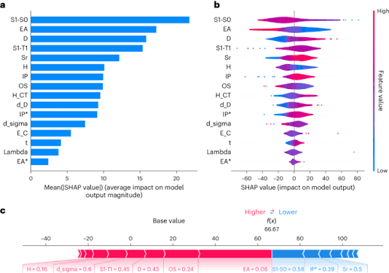
Notes:
Go back to husky analogy and

Slide 17
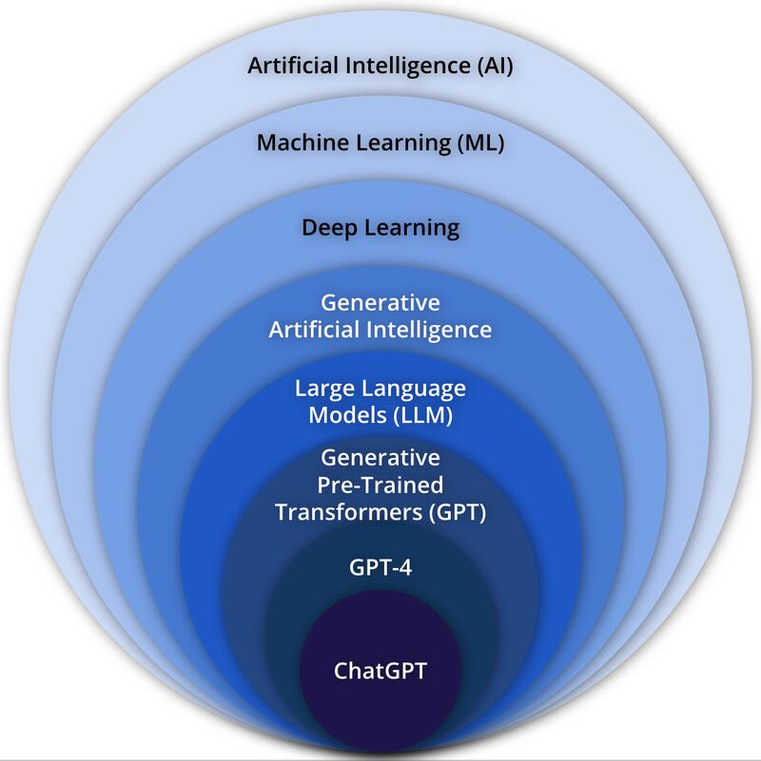
Artificial intelligence
What does it mean to you?

Slide 18
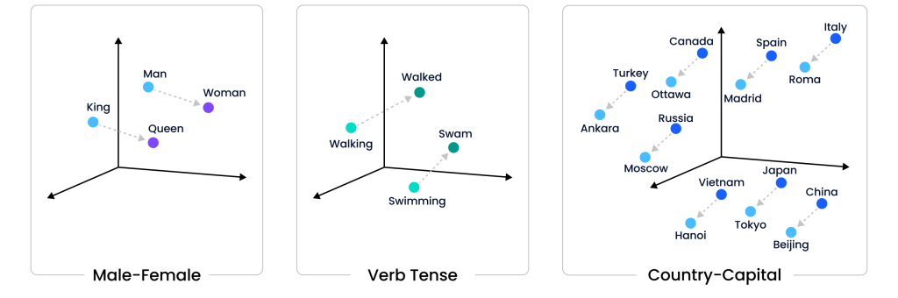
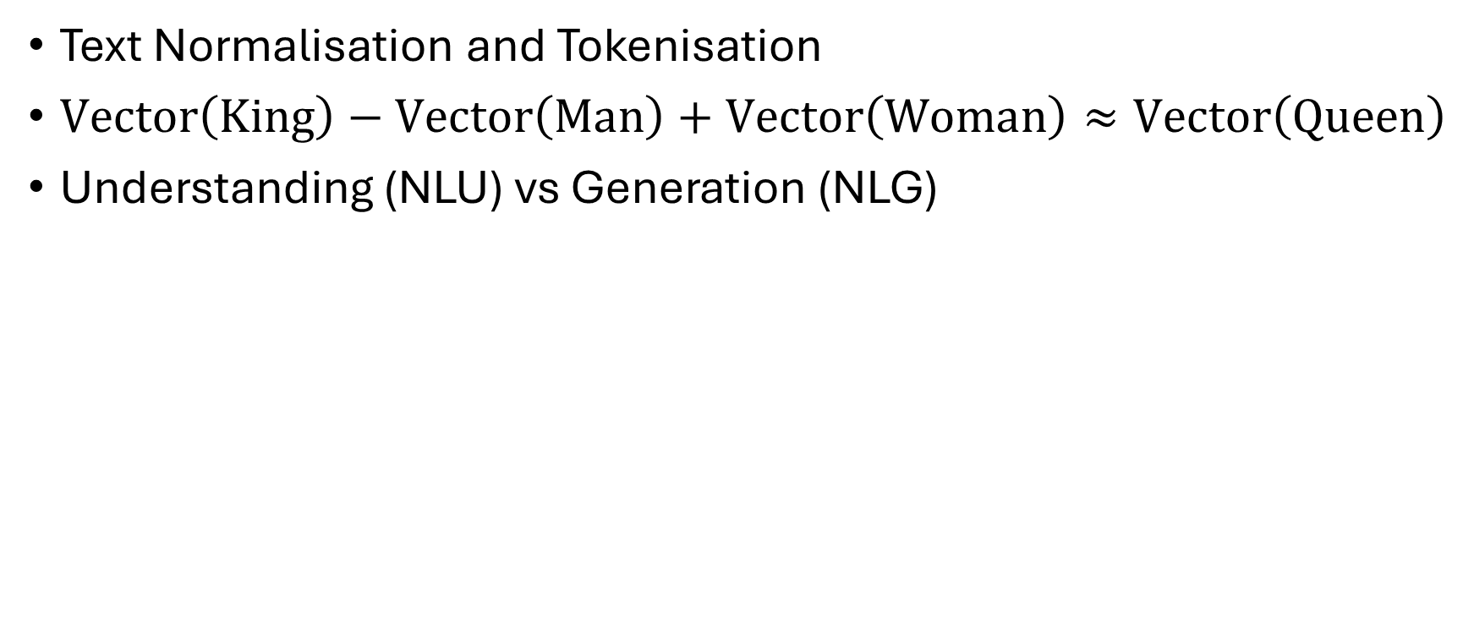
Natural Language Processing (NLP)
Text Normalisation and Tokenisation
$\text{Vector}\left(King\right)−\text{Vector}\left(Man\right)+\text{Vector}\left(Woman\right)≈\text{Vector}\left(Queen\right)$
Understanding (NLU) vs Generation (NLG)
Notes:
100-12288 dimensions from static embeddings to frontier LLMs, talk about tokenisation and how this works and how this then better defines how AI actually works

Slide 19
Deep Learning
Physics-informed machine learning (PINNs)
  Integrating Physical laws into the loss function of neural networks
Data curation and provenance
  Garbage in, garbage out
Uncertainty quantification
  Bayesian deep learning / dropout techniques
Notes:
Explain the basic concept of deep learning and how these specialised models are so good but also so restricted and bring up the benefits of uncertainty quantification in terms of ethics

Slide 20
AI Ethics
Verification
Traceability
Ultimate Liability
Boundary Clarity
Stewardship

Slide 21
I - Verification
Model outputs are probability estimates, not verified truths
Validate against empirical reality before use
Apply physical, statistical, and engineering constraint bounds
Calibration and conformal prediction intervals are required instruments

Slide 22
II - Traceability
Training data provenance must be documented and auditable
Pipelines must be fully reproducible end-to-end
Third-party/open-source models require a formal secondary data attestation
Misrepresenting AI-generated content as your own engineering work is unethical

Slide 23
III - Ultimate Liability
Algorithms carry zero professional liability, engineers do
Certifying an AI-powered system makes you personally accountable for its failure modes
Liability cannot be distributed across pipeline authorship or delegated to the model
Professional accountability cannot be delegated to a computational process

Slide 24
IV - Boundary Clarity
Define explicitly where training distribution ends and extrapolation begins
Use mathematically defensible metrics (e.g. conformal prediction intervals, reconstruction error)
OOD conditions and distributional drift must be systematically detected and disclosed
Create an environment where raising model anomalies is a procedural obligation, not an act of courage

Slide 25
V - Stewardship
Anticipate future failure modes, adversarial vulnerabilities, and dual-use risks
Where serious harm to people or environment is credible, apply the precautionary principle
Technology is advancing faster than governance so pre-emptive action is required
Risk tier determines when precaution becomes mandatory, not uniform maximum controls

Slide 26
The Sustainability Flop
AI is projected to use 1000 TWh of electricity by 2030, if it was a country this would make it the 5th largest energy consumer on earth
AI servers generate significant heat and consume water equal to the domestic needs of 1.3 billion people
AI GPUs contribute millions of tonnes of e-waste annually

Slide 27
How to use AI sustainably
Implement AI selectively
Schedule tasks for when the local power grid is using more sustainable energy
Quantify and monitor the footprint of your usage

Slide 28


